Slide 1
IPv6, ICMP, DNS

Slide 2
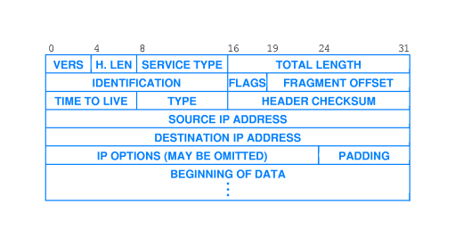
IPv4

Slide 3
IPv4
IPv4 is successful in that the protocol has accommodated changes in hardware technologies, heterogeneous networks, and extremely large scale.
But address space is limited.
IPv4 has no built-in support for new Internet applications.
the interest in collaboration technologies increases

Slide 4
IPv6
Address size: 128 bits
Extension headers
Support for audio and video
Extensible protocol

Slide 5
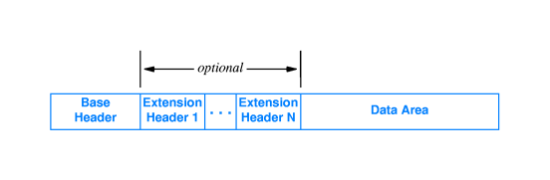
IPv6 Datagram Format

Slide 6
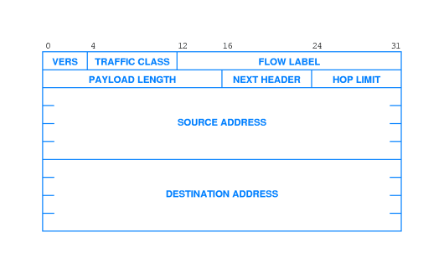
IPv6 Base Header

Slide 7
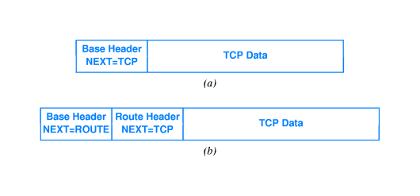
NEXT HEADER

Slide 8
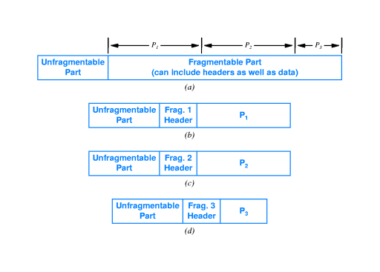
Fragmentation and Path MTU

Slide 9
ICMP as an Error Reporting Mechanism
IP defines a best-effort communication service in which datagrams can be lost, duplicated, or delayed out of order.
However best-effort is not careless.

Slide 10
ICMP
The TCP/IP suite includes ICMP protocol that IP uses to send error message.
Each ICMP message has a type. I.e.
0 Echo reply
3 Destination Unreachable
11 Time exceeded

Slide 11
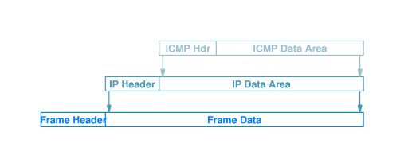
ICMP Message Transport
Messages can be both error messages and informational messages

Slide 12
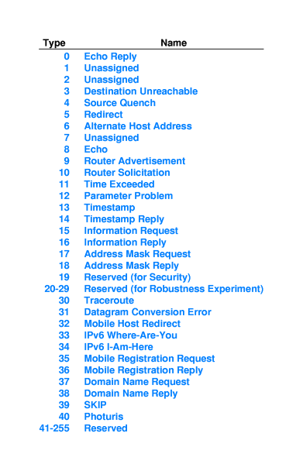
ICMP cont’d…
Ping application
Traceroute application
Path MTU discovery
Make use of ICMP

Slide 13
Naming With the Domain Name System
Symbolic names to define specific computers are required for human understanding
But symbolic names are not convenient for computers

Slide 14
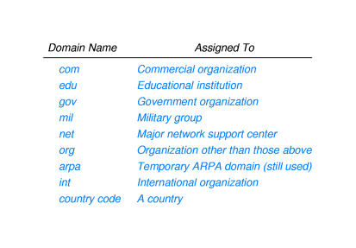
Structure of Computer Names

Slide 15
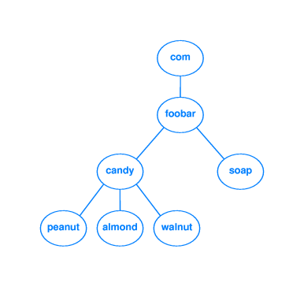
Domain Names within an Organization

Slide 16
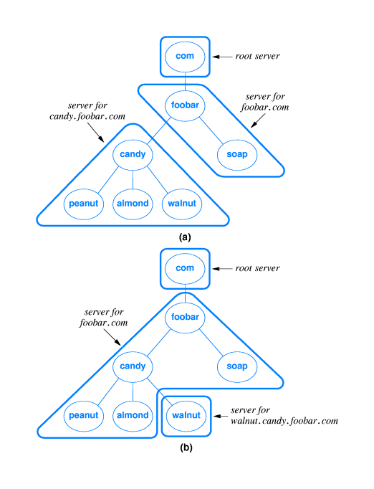

Slide 17
Optimization of DNS Performance
Replicated DNS servers
Caching

